Slide 1
Adult Income Prediction
Lonnie Smith
Project 2 Final Presentation

Slide 2
Adult Income Prediction
The goal is to use a set of features to predict if some makes more than $50,000 a year or not.
The data set contains 48,738 unique records of people.
13 different features.
Dataset distribution is heavy below $50k with 74% of the data and above $50k is 26%

Slide 3
Feature Explanation
Features | Description
Age | Age of each person
Workclass | 8 unique classes
Fnlwgt | Weight assigned to the combination of features
Education | Highest education achieved
Educational Num | Number of years for education
Marital Status | 7 unique classes
Occupation | Profession of person
Features | Description
Relationship | 6 unique classes
Race | 5 unique classes
Gender | Male or Female
Capital Gain | Capital gained by a person
Capital Loss | Capital loss by a person
Hours Per Week | Number of hours working
Native Country | 41 unique classes

Slide 4
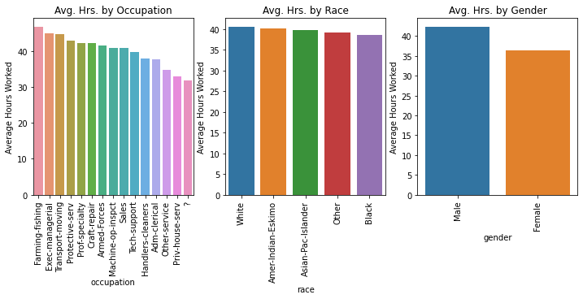
Hours Worked by Occupation
You can see Farming and Fishing as an occupation works the most hours with Private house services and the lowest known.

Slide 5
Hours worked by Race
There is very little separation among races when it comes to hours worked.

Slide 6
Hours worked by Gender
Within this data set men work more than women.

Slide 7
Model Prediction TEST results
Models | Accuracy
KNN Model | 82%
KNN w/PCA (95%) | 81%
KNN w/PCA (95%) & Hyper Tuned | 82%
Gradient Boosting | 82%
XG-Boosting | 85%
From the model analysis performed XG Boosting yielded the best accuracy score at 85%

